Slide 1

Chapter 6 Security and Reliability of Distributed Software and Systems
Lecture 23
Forms-Based Security
Text Chapter 6.2
Yinong Chen

Slide 2
Roadmap of Chapter 6
General Security & Reliability Concepts (Text Section 6.1)
IIS Roles and Windows-Based Security Mechanism
Forms-Based Security Creating an independent security system for Web access control and resource authorization (Text Section 6.2)
Data Encryption and Decryption
Reliability and Security in Windows Communication Foundation
Error Control and Secure Socket Layer for Secure HTTP Connection

Slide 3
Security Check Overview
Client Browser
IIS
IP address and domain permitted?
No
Yes
“None”
Check Web.config authentication attribute
token
token
“Forms”
“Windows”
ASP .Net
No
No
Windows authentication successful?
Forms authentication successful?
Yes
Windows Sever
True
False
Impersonation enabled
?
No
Other resource allowed?
Use impersonated account
Use configuration account
none
Yes
Access Allowed
Access Denied

Slide 4
Entry Point Control in Web.config File
Can be Forms, Windows, or None
<configuration>
<system.web>
<authentication mode=“Forms" />
<identity impersonate=“false"/>
</system.web>
</configuration>
Make sure that the same credential coming from the IIS is applied
The identity element’s attribute impersonate is used for control the access to the resources (files) on the server’s hard drive.

Slide 5
Impersonation Disabled
<identity impersonate = “…”> attribute not defined (not given): The default will be applied:
The application will inherit the identity of the worker process (aspnet_wp.exe), which runs using an account (defined in machine.config) with weaker privileges than the local system account;
By doing so, an intruder will not have the local account access even if security is breached (has administrator’s password). It is because Local System account has access to almost all resources on the local computer that are not specifically denied to it;
The strongest security option – It may be too strong though:
This option may deny a user to access a disk file, e.g., an XML file. In this case, you need to define the attribute (next page).

Slide 6
Impersonation enabled with true or false value
<identity impersonate = "true" userName="domain\user" password="password" />
ASP.NET impersonates the token generated using this identity specified in the Web.config file given in the identity element. This feature is useful for developers to test the program using a different account.
<identity impersonate = "false" > ASP.NET impersonates the token passed to it by IIS, which is either an authenticated user or the anonymous Internet user account. This is the common use.

Slide 7
Forms Security
Forms security is a common way of implementing access control.
Simply ask a user to type credentials (typically a user name and a password) into a Web form.
The credentials can be issued
by the administrator, e.g., using a password generator
through self-registration
The credentials can be saved in different places and in different forms on the server side:
Web.config, in clear text or encrypted
XML or text file
Database
Browser and cookies on the client side

Slide 8
Forms Security
ASP.NET saves the credentials on the server side and on client side: Web browser (temporal) or in cookies (persistent).
When a user attempts to access a protected resource at the first time, ASP.NET automatically redirects the user to the login page.
If the login is successful, ASP.NET then issues the user an authentication ticket in the form of a cookie, and automatically redirects the user back to the page originally requested.
The ticket allows that user to revisit protected portions of the site without having to login again and again. One can control the ticket’s lifetime and decide how long the login is good for.
Both authentication and authorization can be defined.
→ Learn by examples

Slide 9
Files of Forms Authentication/Authorization
The application’s user interface consists of two content pages:
Default.aspx, which can be viewed by anyone
Staff.aspx, which is available only to authenticated users. “Authenticated users”
The management pages consist of
Login.aspx, which asks for a user name and a password.
The valid user names and passwords stored in a Web.config in a virtual root directory
Another Web.config in the sub directory
And more…

Slide 10
Application Architectures
http://venus.eas.asu.edu/WSRepository/FormsSecurity/
FormsSecurity
Default
.aspx
Default
.aspx
Web
.Config
For Authentication
Web
.Config
Login
.aspx
Login
.aspx
Web
.Config
File or DB
Protected
For Authorization
Staff
.aspx
Web
.Config
Staff
.aspx
Web
.Config
Physical Organization
Logical Organization

Slide 11
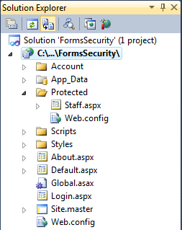
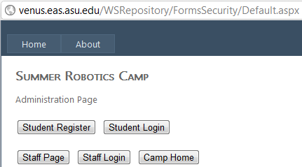
Default.aspx
protected void btnStaff_Click(object sender, EventArgs e)
{
Response.Redirect("Protected/Staff.aspx");
}
}
Transparently redirected to the Login.aspx, whose URL is stored in Web.config, then return to this page

Slide 12
<authentication> Element in Root Web.config
<authentication mode="Windows|Forms|Passport|None"> <forms name="name"
loginUrl="url_of_Login.aspx"
protection="All|None|Encryption|Validation“
timeout="30" path="/" >
requireSSL="true|false"
slidingExpiration="true|false">
<credentials passwordFormat="Clear|SHA1|MD5">
<user name="username" password="password"/>
</credentials>
</forms>
</authentication>
You could store user names and passwords here, but not a good idea

Slide 13
Cryptographic Algorithms
SHA-1 (Secure Hash Algorithm, 0, 1, 2) is a cryptographic hash function designed by the National Security Agency and published by the NIST as a U.S. Federal Information Processing Standard.
MD5 (Message-Digest algorithm 5) is a widely used cryptographic hash function with a 128-bit (16-byte) hash value.
There are many other cryptographic algorithms:
Asymmetric-key
Barrett reduction
DES (Data Encryption Standard) is an algorithm we will discuss later.

Slide 14
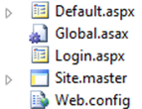
Web.config in the Application Root Directory
<configuration>
<system.web>
<authentication mode="Forms">
<forms name = "LoginForm" loginUrl="Login.aspx" timeout="30" >
<credentials passwordFormat="Clear">
<user name="Julia" password="abc" />
<user name="John" password="45678" />
<user name="Bob" password="123" />
<user name="Alice" password="12345" />
</credentials>
</forms>
</authentication>
</system.web>
</configuration>
Entry address stored here
Even though, one cannot use “View Source” to read the file

Slide 15

Web.config in the “Protected” Sub Directory
<configuration>
<system.web>
<authorization>
<deny users="?" />
</authorization>
</system.web>
</configuration>
?: Deny unauthenticated users

Slide 16
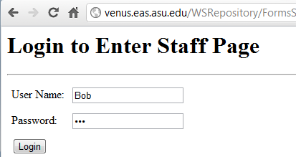
Login.aspx
<html>
<body>
<h1> Login to access Staff page
</h1> <hr>
<form runat="server">
<table cellpadding=“4">
<tr>
<td> User Name: </td>
<td>
<asp:TextBox ID= "txtUserName" RunAt="server" />
</td>
</tr>
<tr><td> Password: </td><td>
<asp:TextBox ID=“txtPassword" TextMode="password"
RunAt="server" />
</td>
</tr>
<tr>
<td>
<asp:Button Text= "btnLogin" OnClick="LoginFunc" RunAt="server" />
</td>
</tr>
</table>
</form>
<hr>
<h3><asp:Label ID="Output" RunAt="server"/> </h3>
</body>
</html>
<script language="C#" runat="server">
void LoginFunc(Object sender, EventArgs e)
{
if (FormsAuthentication.Authenticate (txtUserName.Text, txtPassword.Text))
FormsAuthentication.RedirectFromLogin (UserName.Text, false);
else
Output.Text = "Invalid login";
}
</script>
Save credential?
Look up the Web.config
Persistent option not checked.

Slide 17
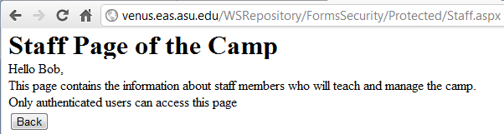
Staff.aspx in the Protected Sub Directory
<html xmlns="http://www.w3.org/1999/xhtml">
<head runat="server"> <title>staff page</title> </head>
<body>
<form id="form1" runat="server">
<h1>Staff Page of the Camp</h1>
<div>
<% Response.Write("Hello " + Context.User.Identity.Name + ", "); %> <br />
This page contains the information about staff members who will teach
and manage the camp. Only authenticated users can access this page .<br />
</div>
</form>
</body>
</html>

Slide 18
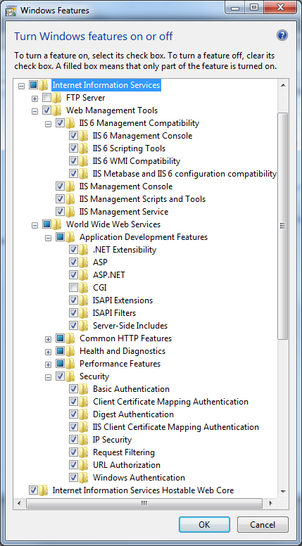
Deployment
You can use
.Net local host
Your Windows IIS
WebStrar (Final Deployment)
V-Lab
If you use your own IIS or V-Lab, you need to turn on your IIS: Control Panel → Programs → Programs and Features → Turn Windows Features on or off

Slide 19
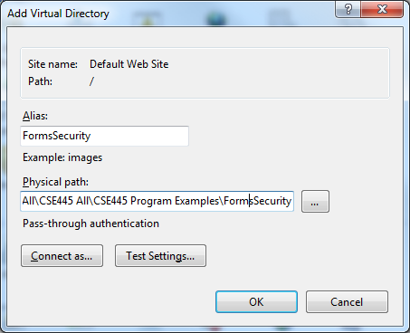
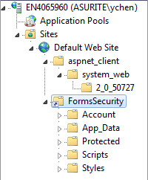
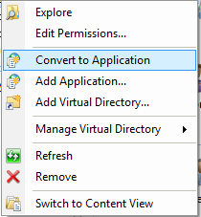
Create Virtual Directory and Convert to Application
Administrative Tools → IIS Manager
Create a virtual directory and link your project folder to the virtual directory
Convert to Application
Right click

Slide 20
Testing in Action: Steps 1 and 2
Start the application
Click on “Staff” button

Slide 21
Steps 3 and 5 in Action
Staff page uses Response.Redirect to go to Protected/Staff.aspx. But because Staff.aspx is viewable only by authenticated users, ASP.NET displays the login form in Login.aspx.
4. Type “Bob’ into the user name field and “123” into the password field.

Slide 22
Step 5 in Action
Staff.aspx appears. Because you are now an authenticated user, you have been issued an authentication ticket that accompanies subsequent requests as a cookie.

Slide 23
Configure the Authorization using the Web.config in the Protected Sub Directory
* all
<configuration>
<system.web>
<authorization>
<deny users="?" />
</authorization>
</system.web>
</configuration>
<allow users= "*" />
<allow users = “Alice" />
<deny users = "*" />
<deny users "*" />
<allow users = “Alice" />
? unauthenticated

Slide 24
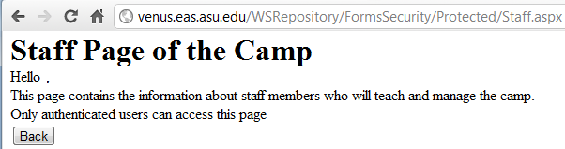
Apply <allow users="*" />
<configuration> <system.web>
<authorization>
<allow users="*" />
</authorization>
</system.web> </configuration>
You will enter the protected page without being identified, and thus, your name cannot be printed.

Slide 25
Different Pages with Different Authorizations
How Do You Create Different Pages with Different Authorizations?
FormsSecurity
Default
.aspx
Web
.Config
Login
.aspx
Web.config Authorization2
Web.config Authorization1
Staff
Student
Staff.aspx
Web
.Config
Student
.aspx
Web
.Config

Slide 26
Problems of using Web.config for Authentication
Users IDs and password are buried in many other data;
Authentication is slow (sequential comparison) and unmanageable if the number of users is large;
Authorization is unmanageable if accessibility needs to be changed from time to time.
The method FormsAuthentication.Authenticate is obsolete: Not support in .Net 4.5 to discourage its use
Force you to write your own authenticate methods to
Save credentials in XML file/XML database
Save credentials in relational databases
Save credentials in Web.config if you want to!

Slide 27
Write My Own Authentication Method (1)
The application’s interface consists of two pages:
Default.aspx can be viewed by anyone
Staff.aspx is available only to authenticated users.
The management pages consist of
Login.aspx, which asks for a user name and a password.
Web.config in the virtual root directory
The valid user names and passwords stored in a Web.config in a secret sub directory

Slide 28
Login.aspx: Part 1 HTML (GUI)
<html>
<body>
<h1>Please Log In</h1> <hr>
<form runat="server">
<table cellpadding="8">
<tr> <td>User Name:</td>
<td> <asp:TextBox ID="UserName" RunAt="server" /></td> </tr>
<tr> <td> Password: </td>
<td><asp:TextBox ID="Password" TextMode="password"
RunAt="server" /> </td> </tr>
<tr>
<td><asp:Button Text="Log In" OnClick="LoginFunc"
RunAt="server" /></td>
<td><asp:CheckBox Text="Keep me signed in" ID="Persistent"
RunAt="server"/> </td>
</tr>
</table>
</form>
<hr> <h3><asp:Label ID="Output" RunAt="server" /></h3>
</body>
</html>
continued

Slide 29
Login.aspx: Part 2 C# with My Own Method
<script language="C#" runat="server">
void LoginFunc (Object sender, EventArgs e)
{
if (myAuthenticate (UserName.Text, Password.Text))
FormsAuthentication.RedirectFromLogin (UserName.Text, Persistent.Checked);
else
Output.Text = "Invalid login";
}
It will automatically search Web.config for credentials
if (FormsAuthentication.Authenticate (UserName.Text, Password.Text))
continued

Slide 30
Login.aspx: Part 3, Using an XML File
bool myAuthenticate (string username, string password) {
string fLocation = Path.Combine(Request.PhysicalApplicationPath, @"App_Data\Users.xml");
if (File.Exists(fLocation))
{
FileStream FS= new FileStream(fLocation, FileMode.Open);
XmlDocument xd = new XmlDocument();
xd.Load(FS);
XmlNode node = xd;
XmlNodeList children = node.ChildNodes;
foreach (XmlNode child in children)
{
// use hash function if the credential is hashed
// check if the username and password exist in the XML file;
}
}
}

Slide 31
Login.aspx: Part 3, Accessing DB (Text Chapter 10)
bool myAuthenticate (string username, string password) {
SqlConnection connection = new SqlConnection ("server=localhost;database=weblogin;uid=sa;pwd=letme");
try {
connection.Open ();
StringBuilder builder = new StringBuilder ();
builder.Append ("select count (*) from users " + "where username = \' ");
builder.Append (username);
builder.Append ("\' and cast (rtrim (password) as " + "varbinary) = cast (\' ");
builder.Append (password);
builder.Append ("\' as varbinary)");
SqlCommand command = new SqlCommand (builder.ToString (), connection);
int count = (int) command.ExecuteScalar ();
return (count > 0);
}
catch (SqlException) { return false; }
finally { connection.Close (); }
}
</script>
If count > 0, an entry is found!
We can make password more secure by not allowing “read” the database.

Slide 32
Signing Out
It is always a good practice to provide the users a signing out button, for two reasons:
More secure
Resources can be recycled immediately
Void Signout(object sender, EventArgs e)
{
FormsAuthentication.SignOut();
Server.Transfer(“Default.aspx”);
}

Slide 33
Example: Applying for a Credit Account
Apply for Access
Check Credential
Use ID to Create Account
Issue an ID / User Name
Apply for Access
Credit score Web service
Name
SSN
Approval?
Yes
Create account
Address
Check credit score and apply other criteria
DoB
No
Issue User ID
You do not qualify
sundevil1
Store User Info
Create an Account
User ID
XML file account.xml
sundevil1
Password
•••••••
Yes
Yes
Retype Password
Match?
Strong?
Hash
•••••••
No
No
Store password
Login
User ID
Hash
Check existence
Password

Slide 34
Build-in Account Management Using Database
Access Control with Self-Registration

Slide 35
User Registration & Account Management
So far we have discussed how to authenticate and authorize users if they have already their credentials stored on the server of the application.
We assumed that the administrator has created the credentials for the users.
What should we do if we want to allow users to register and create their own credentials?
ASP .Net has created standard Web controls to implement such functions.
Let us continue with our Forms Security example…

Slide 36
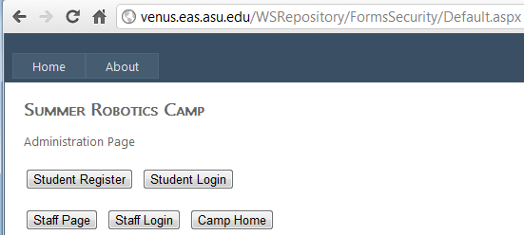

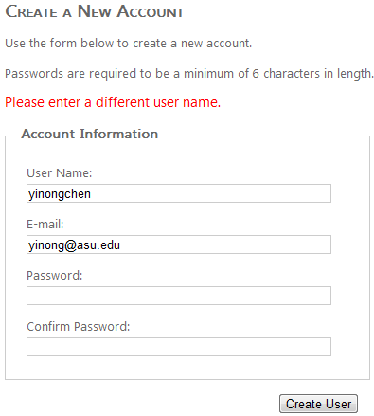
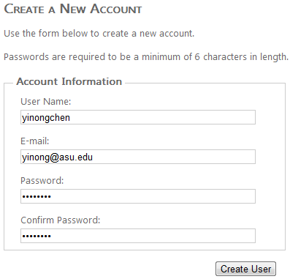
Case Study
http://venus.eas.asu.edu/WSRepository/FormsSecurity/Default.aspx
Find the “Image verifier” service in ASU Repository.

Slide 37
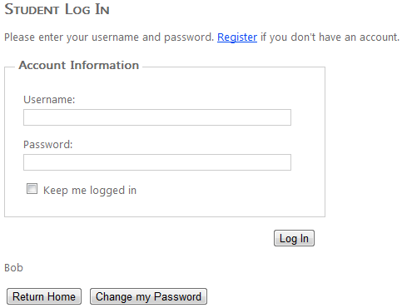
Case Study
http://venus.eas.asu.edu/WSRepository/FormsSecurity/Default.aspx
Show login name if already logged in

Slide 38
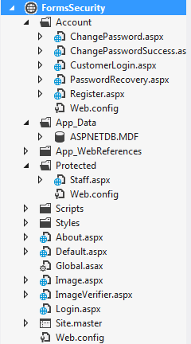
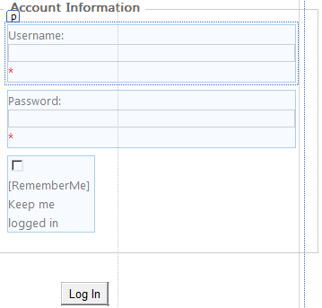
Built-in Support to Account Management

Slide 39
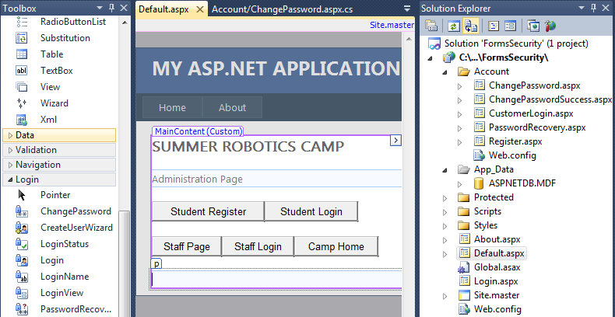
Creating Account Management Pages

Slide 40
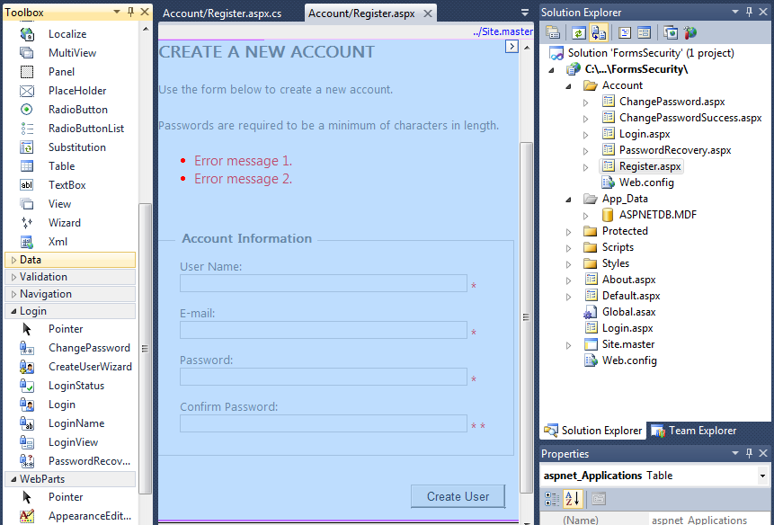
Register Page

Slide 41
The Code Behind the “Register”
using System;
using System.Web.Security; // Contains FormsAuthentication class
public partial class Account_Register : System.Web.UI.Page {
protected void Page_Load(object sender, EventArgs e) {
RegisterUser.ContinueDestinationPageUrl = Request.QueryString["ReturnUrl"];
}
protected void RegisterUser_CreatedUser(object sender, EventArgs e) {
FormsAuthentication.SetAuthCookie(RegisterUser.UserName, false /* createPersistentCookie */);
string continueUrl = RegisterUser.ContinueDestinationPageUrl;
if (String.IsNullOrEmpty(continueUrl)) {
continueUrl = "~/";
}
Response.Redirect(continueUrl);
} }

Slide 42
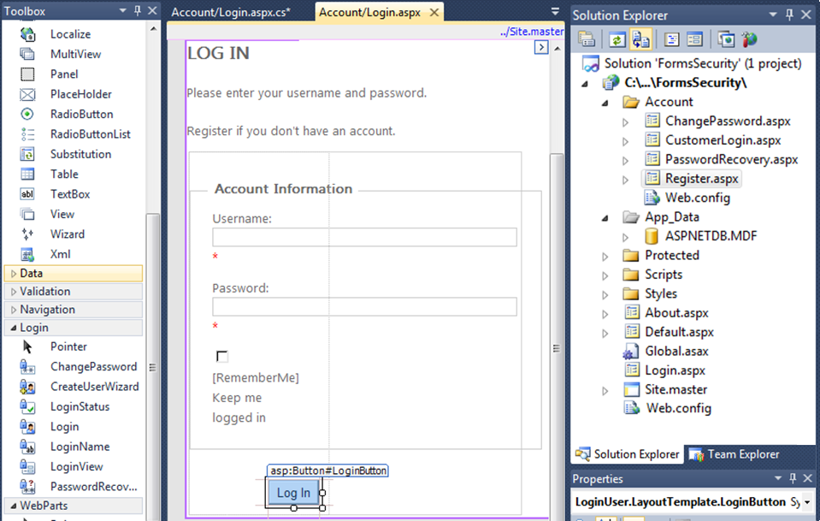
Creating The Customer Login Page
Different

Slide 43
The Code Behind the Built-in “Log in” Page
using System;
using System.Web; // contains HttpUtility class
public partial class Account_Login : System.Web.UI.Page {
protected void Page_Load(object sender, EventArgs e) {
RegisterHyperLink.NavigateUrl = "Register.aspx?ReturnUrl=" + HttpUtility.UrlEncode(Request.QueryString["ReturnUrl"]);
}
protected void LoginButton_Click(object sender, EventArgs e) { }
protected void btnRtnHome_Click(object sender, EventArgs e) {
Response.Redirect("~/Default.aspx");
}
protected void btnChangePwd_Click(object sender, EventArgs e) {
Response.Redirect("ChangePassword.aspx");
}
}

Slide 44
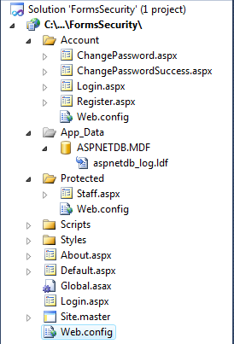
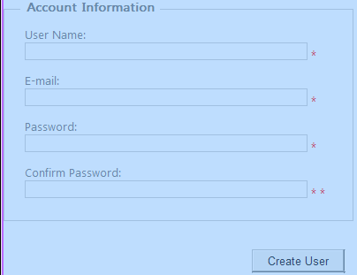
Visual Studio Built-in Support to Security
Database

Slide 45
Customer Accounts in Database
When the Web controls in the Login part of the Toolbox is used, a database storage object will be created automatically and placed in the App_Data folder of the project.
The database object name is: ASPNETDB.MDF
ASP .Net configured this database object to work with SQL Server Express, with the data source default name = SQLEXPRESS, which is the default name.
SQL connection string is stored in machine.config file

Slide 46
Change Database Connection String
When you install SQL Express, do not use the default name SQLEXPRESS, as the name may have been used by the server, causing conflict when you deploying the project;
If a different name is used when installing SQL express, or full SQL is used:
Open and edit the <connectionStrings) element:
C:\Windows\Microsoft.NET\Framework\v4.0\Config\machine.config
<connectionStrings>
<add name="LocalSqlServer" connectionString="data source=.\SQLEXPRESS; Integrated Security=SSPI; AttachDBFilename=|DataDirectory|aspnetdb.mdf; User Instance=true" providerName="System.Data.SqlClient"/>
</connectionStrings>

Slide 47
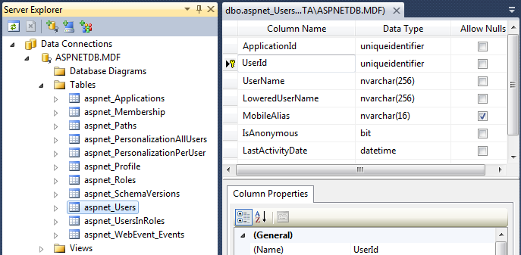
SQL Express Data Object Created
Manipulation of the database will be discussed in the Part 2 of the text Chapter 10: LINQ. It is not required in this course.

Slide 48
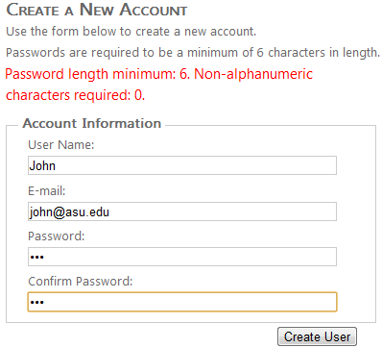
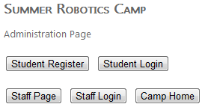
Demonstration
The example with registration page and database:
http://venus.eas.asu.edu/WSRepository/FormsSecurity/

